Slide 1
The perfect data science experience
(versus real life)
Brian Caffo, Jeff Leek, Roger Peng
@bcaffo
www.bcaffo.com

Slide 2

The perfect data science experiment

Slide 3
Attributes
Clearly defined hypotheses of interest, specified a priori
Experimental design available
Randomization used across a treatment of interest
Stratification on nuisance variables
Random sample from a population of interest
Data directly able to interrogate hypotheses
Dataset creation/merging goes smoothly
No missing data or dropout
Analysis is robust without need for advanced modeling
Conclusions are clear
Parsimonious knowledge gained via the experiment
Decision is obvious given the data

Slide 4

Real life

Slide 5
Attributes of data science in real life
Data is needed to inform hypotheses and interrogate them
Multiple comparisons are an issue
Experimental design options are limited. Or, data is observational
Randomization is not available
Data is retrospective
The population being studied isn’t the population of interest
The data don’t have the exact measurements that you need to evaluate the hypotheses
Dataset is problematic
Merging is problematic with multiple matches, no matches
Data entry errors
Missing data
Advanced modeling is required, similarly advanced computing needed to fit the model, issues with robustness and bugs
Conclusions are indeterminant
Decision is not substantially further informed by the data

Slide 6
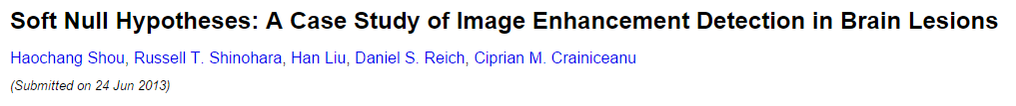
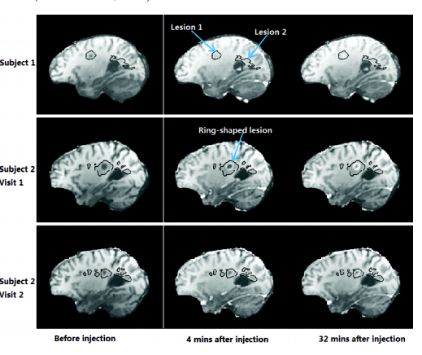
Some examples

Slide 7
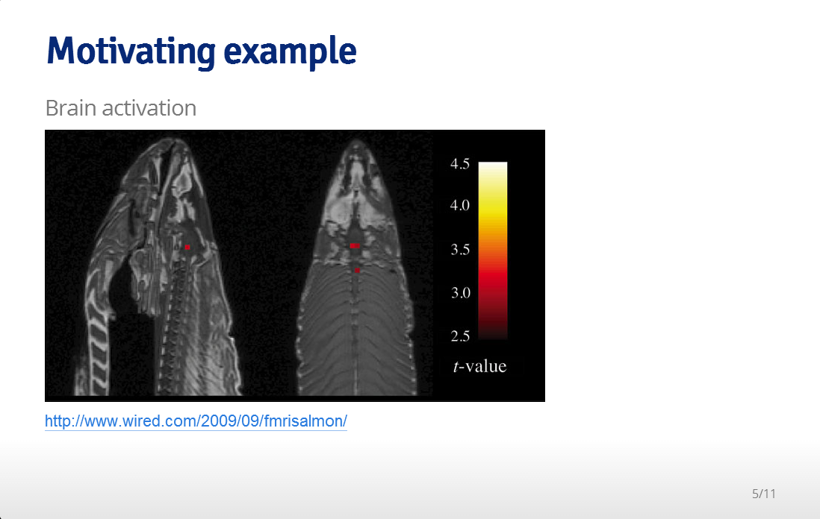
Multiple comparisons

Slide 8


Randomization

Slide 9
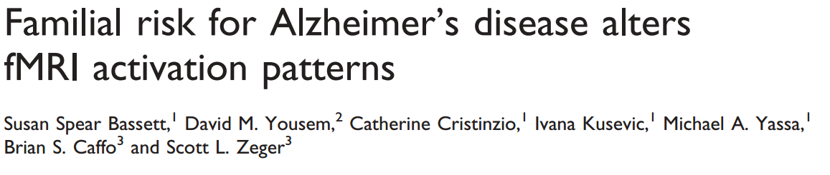
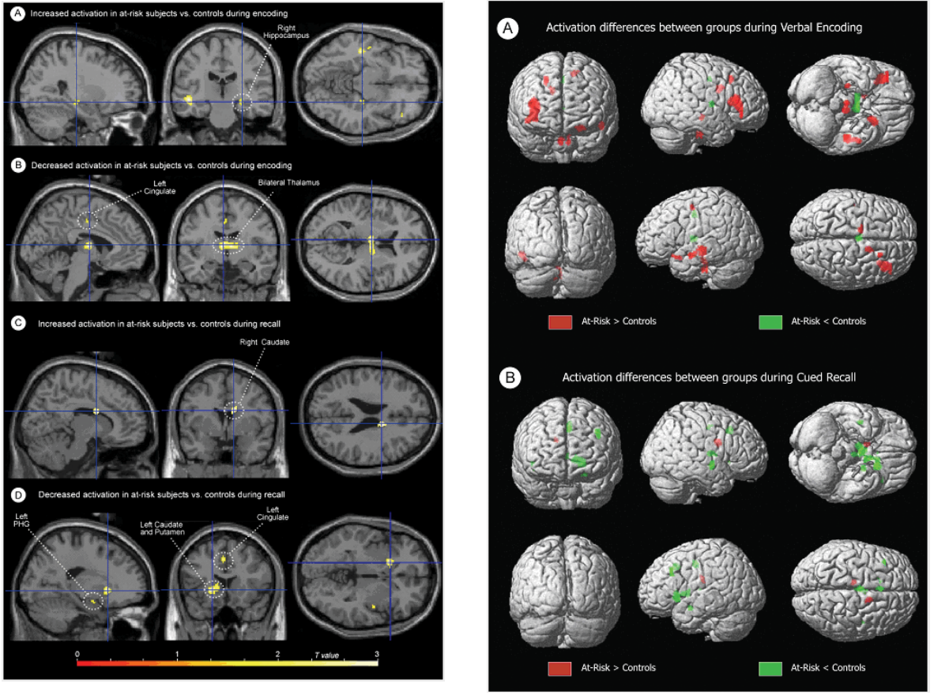
Data available to directly interrogate hypotheses

Slide 10
In this class
We’ll dig through the various facets of the perfect data science experience versus real life
We’ll give practical recommendations for the messy situations that arise in real life

